Slide 1
A Declarative Approach to Leverage “Big Code” for Program Reasoning
Xin Zhang Georgia Tech
Joint work with Radu Grigore, Aditya Kamath, Sulekha Kulkarni, Ravi Mangal, Mayur Naik, Aditya Nori, and Hongseok Yang
Notes:
Hi everybody, I am Xin from Georgia Tech. My research area is programming languages. I mainly work on program analysis. Today I’m going to talk about a declarative approach to leverage “Big Code” for program reasoning. This is a joint work with people from Georgia Tech, Oxford, and Microsoft Research.

Slide 2
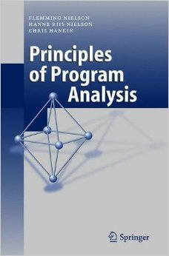

Program Analysis: State of the Practice
Program
Analysis
Program
Analysis
Approximations
Exact solutions impossible to compute
Properties impossible to state precisely
Analysis Writer (Alice)
Missing or opaque program fragments
…
Notes:
- Program analysis aims at proving certain properties of a given program.
Designing program analyses that work in practice remains as much as art as its science
Current approach: Knowledgeable writer designs analyses
Also, needs experience. Uses experience to decide what approximations to incorporate.
Why approximations?
Undecidable problems
Properties ill-defined, For example, consider an analysis trying to find races in the program. Many data races are benign and programmers do want them to be reported. Notion of benign is subjective and not well-defined.
Most large programs call native code i.e code for which we don’t have source code but only the binaries. These are invisible to analysis tools that operate on source/assembly code.
No well defined recipe for choosing approximations. And the guiding principle employed is to choose approximations such that analysis still produces useful results inspite of the inherent imprecision due to the approximations.

Slide 3
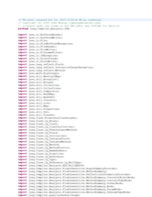
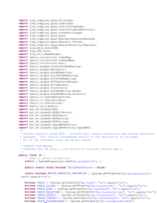

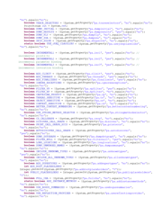

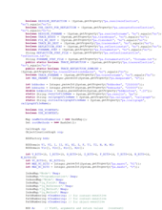
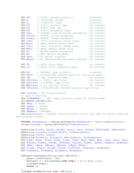
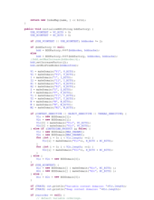
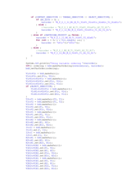
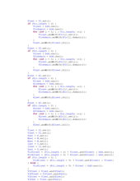
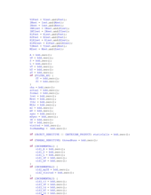
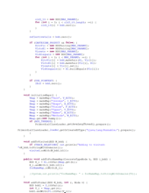
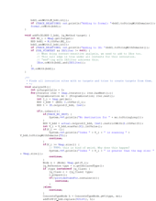
Program Analysis: State of the Practice
People ignore the tool if
more than 30% false positives
are reported …
A Few Billion Lines of Code Later: Using Static Analysis to Find Bugs in the Real World
Coverity Inc, CACM 2010
“
Program
Analysis
”
Analysis User (Bob)
Bug Reports
Notes:
- On the other side of current picture,
User runs analysis on programs.
For large programs, analysis might produce many reports.
User needs to analyze the reports and fix the bugs.
Problem! Many reports are false alarms.
False alarms because approximations.
Approximations are necessary but guide the approximations.
Much effort wasted leading to user frustration.
Stop using tool.
Key issue: the writer’s notion of usefulness when choosing approximations did not match the user’s notion

Slide 4
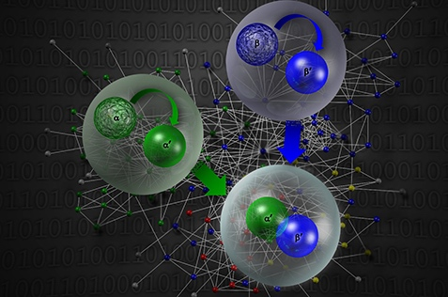
Our Vision
Enable program analyses to evolve over time to overcome the impact of approximations by leveraging “Big Code”.
“Significantly advance how software is built, debugged, verified, maintained and understood … by leveraging deep program analyses to create a database of properties and vulnerabilities drawn from billions of lines of code.”
DARPA MUSE (2014-18) Mining and Understanding
Software Enclaves

Slide 5
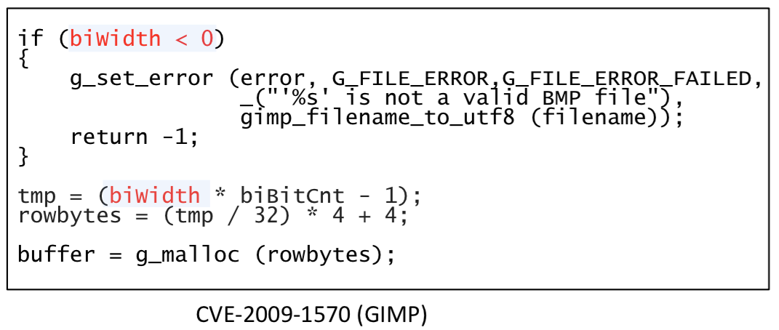
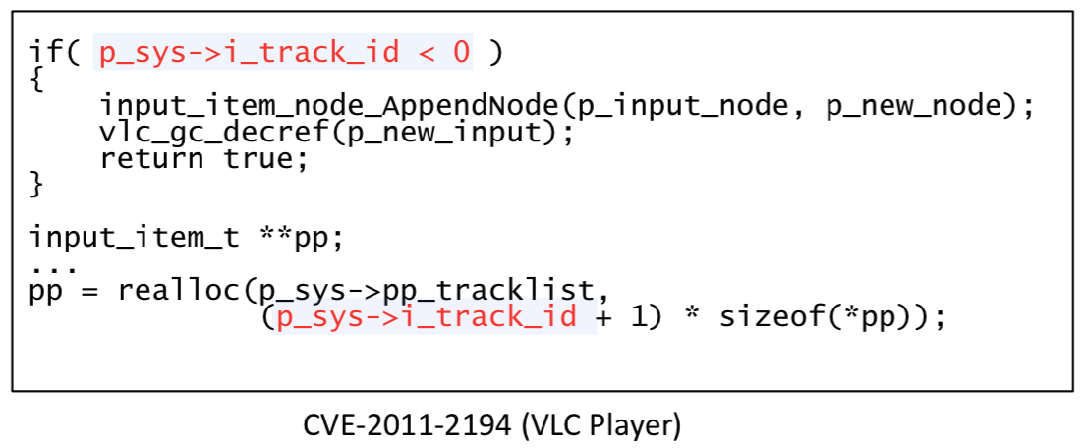
An Example
if (args->buffer_count < 1) {
DRM_ERROR("execbuf2 with %d buffers\n", args->buffer_count);
return -EINVAL;
}
exec2_list = kmalloc(sizeof(*exec2_list) * args->buffer_count,
GFP_KERNEL | __GFP_NOWARN | __GFP_NORETRY);
CVE-2013-0913 (Linux kernel)

Slide 6
Our Solution: Petablox
A system to synthesize Big Code based solutions for program analyses specified in a concise, expressive, and declarative language.

Slide 7




Benefits of Declarative Analysis
Separates analysis specification from implementation
Enables sophisticated implementations
Provides natural program specifications
…
Input relations:
edge(a, b)
Output relations:
path(a, b)
Rules:
1path(a, a).
2path(a, c) :- path(a, b), edge(b, c).

Slide 8
Idea: Synthesize Analysis Use-Cases
Counterexample-guided abstraction refinement [PLDI 2014]
Incorporating user feedback in analysis results
[FSE 2015]
Reusing analysis results on shared libraries for accelerating analysis
[OOPSLA 2016]
Input relations:
edge(a, b)
Output relations:
path(a, b)
Rules:
1path(a, a).
2path(a, c) :- path(a, b), edge(b, c).

Slide 9

A Use-Case: Abstraction Refinement
Abstraction
Precision
Scalability
Xin Zhang, Ravi Mangal, Radu Grigore, Mayur Naik, and Hongseok Yang. On Abstraction Refinement for Program Analyses in Datalog. PLDI 2014

Slide 10
A Use-Case: Abstraction Refinement
Learning Optimum Abstractions Across Analysis Runs
Xin Zhang, Ravi Mangal, Radu Grigore, Mayur Naik, and Hongseok Yang. On Abstraction Refinement for Program Analyses in Datalog. PLDI 2014

Slide 11
Example: Pointer Analysis
f(){
v1 = new ...
v2 = id1(v1)
v3 = id2(v2)
assert(v3 != v1) q1
}
id1(v){ return v }
g(){
v4 = new ...
v5 = id1(v4)
v6 = id2(v5)
assert(v6 != v1) q2
}
id2(v){ return v }

Slide 12
Pointer Analysis via Graph Reachability
1
4
f(){
v1 = new ...
v2 = id1(v1)
v3 = id2(v2)
assert(v3!=v1) q1
}
id1(v){ return v }
g(){
v4 = new ...
v5 = id1(v4)
v6 = id2(v5)
assert(v6!=v1) q2
}
id2(v){ return v }
7
2
5
8
3
6
assert(v6!=v1) holds if there is no path from 1 to 6.
assert(v3!=v1) holds if there is no path from 1 to 3.
Analysis Writer (Alice)

Slide 13
Analysis Specification in Datalog
Input relations: Output relations:
edge(a, b) path(a, b)
Rules:
path(a, a).
path(a, c) :- path(a, b), edge(b, c).
If there is a path from a to b, and there is an edge from b to c, then there is a path from a to c.
Analysis Writer (Alice)

Slide 14

Analysis Evaluation in Datalog
1
4
Input relations: Output relations:
edge(a, b) path(a, b)
Rules:
path(a, a).
path(a, c) :- path(a, b), edge(b, c).
f(){
v1 = new ...
v2 = id1(v1)
v3 = id2(v2)
assert(v3!=v1) q1
}
id1(v){ return v }
g(){
v4 = new ...
v5 = id1(v4)
v6 = id2(v5)
assert(v6!=v1) q2
}
id2(v){ return v }
7
2
5
8
path(1,1)
edge(1,7)
3
6
edge(7,2)
path(1,7)
edge(7,5)
edge(2,8)
path(1,2)
path(1,5)
edge(5,8)
edge(8,3)
path(1,8)
edge(8,6)
false alarm!
Analysis User (Bob)
path(1,3)
path(1,6)

Slide 15
A More Precise Abstraction
1
4
f(){
v1 = new ...
v2 = id1(v1)
v3 = id2(v2)
assert(v3!=v1) q1
}
id1(v){ return v }
g(){
v4 = new ...
v5 = id1(v4)
v6 = id2(v5)
assert(v6!=v1) q2
}
id2(v){ return v }
7_{f}
7
7_{g}
2
5
8_{f}
8
8_{g}
path(1,1)
edge(1,7)
3
6
edge(7,2)
path(1,7)
edge(7,5)
edge(2,8)
path(1,2)
path(1,5)
edge(5,8)
edge(8,3)
path(1,8)
edge(8,6)
false alarm!
Analysis User (Bob)
path(1,3)
path(1,6)

Slide 16

A More Precise Abstraction
1
4
f(){
v1 = new ...
v2 = id1(v1)
v3 = id2(v2)
assert(v3!=v1) q1
}
id1(v){ return v }
g(){
v4 = new ...
v5 = id1(v4)
v6 = id2(v5)
assert(v6!=v1) q2
}
id2(v){ return v }
7_{f}
7
7_{g}
2
5
8_{f}
8
8_{g}
path(1,1)
edge(1,7_{f})
3
6
edge(7_{f},2)
path(1,7_{f})
edge(7_{g},5)
edge(2,8_{f})
path(1,2)
path(1,5)
edge(5,8_{g})
edge(8_{f},3)
path(1,8_{f})
edge(8_{g},6)
false alarm!
Analysis User (Bob)
path(1,3)
path(1,6)

Slide 17
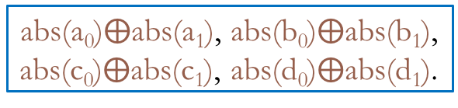
Abstraction Refinement
Input relations: Output relations:
edge(a, b), abs(n) path(a, b)
Rules:
path(a, a).
path(a, c) :- path(a, b), edge(b, c, n), abs(n).
a₁
1
a₀
b₀
4
b₁
Input relations: Output relations:
edge(a, b) path(a, b)
Rules:
path(a, a).
path(a, c) :- path(a, b), edge(b, c).
7_{f}
7
7_{g}
a₁
a₀
b₀
b₁
c₁
2
5
c₀
d₀
d₁
8_{f}
8
8_{g}
abs(a₀)$⨁$abs(a₁), abs(b₀)$⨁$abs(b₁),
abs(c₀)$⨁$abs(c₁), abs(d₀)$⨁$abs(d₁).
c₁
c₀
d₀
d₁
3
6
16 possible abstractions in total
Query Tuple | Original Query
q₁: path(1, 3) | assert(v3!=v1)
q₂: path(1, 6) | assert(v6!=v1)

Slide 18
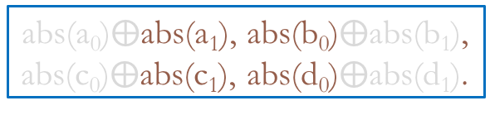
Desired Result
a₁
1
a₀
b₀
4
b₁
Input relations: Output relations:
edge(a, b), abs(n) path(a, b)
Rules:
path(a, a).
path(a, c) :- path(a, b), edge(b, c, n), abs(n).
7_{f}
7
7_{g}
a₁
a₀
b₀
b₁
c₁
2
5
c₀
d₀
d₁
8_{f}
8
8_{g}
abs(a₀)$⨁$abs(a₁), abs(b₀)$⨁$abs(b₁),
abs(c₀)$⨁$abs(c₁), abs(d₀)$⨁$abs(d₁).
c₁
c₀
d₀
d₁
3
6
Query | Answer
q₁: path(1, 3) | Impossibility
q₂: path(1, 6) | a₁b₀c₁d₀

Slide 19
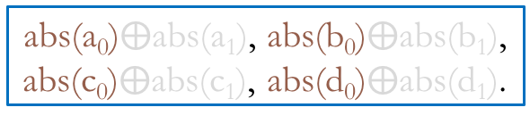
Iteration 1
a₁
1
a₀
b₀
4
b₁
Input relations: Output relations:
edge(a, b), abs(n) path(a, b)
Rules:
path(a, a).
path(a, c) :- path(a, b), edge(b, c, n), abs(n).
7_{f}
7
7_{g}
a₁
a₀
b₀
b₁
c₁
2
5
c₀
d₀
d₁
8_{f}
8
8_{g}
abs(a₀)$⨁$abs(a₁), abs(b₀)$⨁$abs(b₁),
abs(c₀)$⨁$abs(c₁), abs(d₀)$⨁$abs(d₁).
c₁
c₀
d₀
d₁
3
6
Query | Eliminated Abstractions
q₁: path(1, 3)
q₂: path(1, 6)

Slide 20
Iteration 1 - Derivation Graph
path(1,1)
edge(1,7,a₀)
abs(a₀)
abs(a₀)
edge(7,2,a₀)
path(1,7)
edge(7,5,b₀)
abs(b₀)
abs(c₀)
edge(2,8,c₀)
path(1,2)
path(1,5)
edge(5,8,d₀)
abs(d₀)
abs(c₀)
edge(8,3,c₀)
path(1,8)
edge(8,6,d₀)
abs(d₀)
path(1,3)
path(1,6)

Slide 21
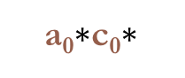
Iteration 1 - Derivation Graph
path(1,1)
edge(1,7,a₀)
abs(a₀)
abs(a₀)
edge(7,2,a₀)
path(1,7)
edge(7,5,b₀)
abs(b₀)
abs(c₀)
edge(2,8,c₀)
path(1,2)
path(1,5)
edge(5,8,d₀)
abs(d₀)
abs(c₀)
edge(8,3,c₀)
path(1,8)
edge(8,6,d₀)
abs(d₀)
path(1,3)
path(1,6)
a₀$∗$c₀$∗$

Slide 22
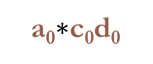
Iteration 1 - Derivation Graph
path(1,1)
edge(1,7,a₀)
abs(a₀)
abs(a₀)
edge(7,2,a₀)
path(1,7)
edge(7,5,b₀)
abs(b₀)
abs(c₀)
edge(2,8,c₀)
path(1,2)
path(1,5)
edge(5,8,d₀)
abs(d₀)
abs(c₀)
edge(8,3,c₀)
path(1,8)
edge(8,6,d₀)
abs(d₀)
path(1,3)
path(1,6)
a₀$∗$c₀$\text{d}\text{0}$

Slide 23
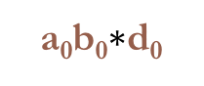
Iteration 1 - Derivation Graph
path(1,1)
edge(1,7,a₀)
abs(a₀)
abs(a₀)
edge(7,2,a₀)
path(1,7)
edge(7,5,b₀)
abs(b₀)
abs(c₀)
edge(2,8,c₀)
path(1,2)
path(1,5)
edge(5,8,d₀)
abs(d₀)
abs(c₀)
edge(8,3,c₀)
path(1,8)
edge(8,6,d₀)
abs(d₀)
path(1,3)
path(1,6)
a₀b₀$∗$d₀

Slide 24
Iteration 1 - Derivation Graph
a₁
1
a₀
b₀
4
b₁
7_{f}
7
7_{g}
a₁
a₀
b₀
b₁
c₁
2
5
c₀
d₀
d₁
8_{f}
8
8_{g}
c₁
c₀
d₀
d₁
3
6
Query | Eliminated Abstractions
q₁: path(1, 3) | a₀*c₀* (4/16)
q₂: path(1, 6) | a₀*c₀d₀, a₀b₀*d₀ (3/16)
abs(a₀)$⨁$abs(a₁), abs(b₀)$⨁$abs(b₁),
abs(c₀)$⨁$abs(c₁), abs(d₀)$⨁$abs(d₁).

Slide 25
Encoding in MaxSAT
abs(a₀)$⨁$abs(a₁), abs(b₀)$⨁$abs(b₁),
abs(c₀)$⨁$abs(c₁), abs(d₀)$⨁$abs(d₁).

Slide 26
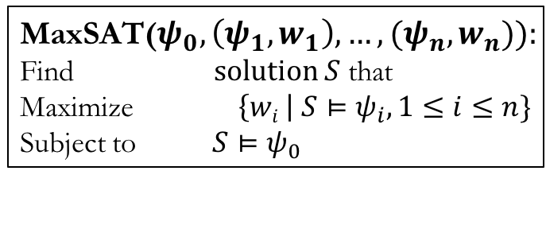
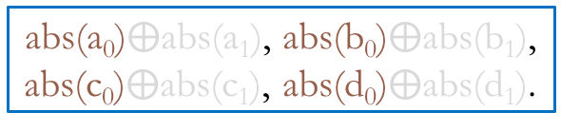
Encoding in MaxSAT
Hard clauses
Soft clauses
MaxSAT($ψ_{0},\left(ψ_{1},w_{1}\right),…,(ψ_{n},w_{n})):$
Find $solution S$ that
Maximize $\left\{wi \right| S⊨ψ_{i}, 1≤i≤n\}$
Subject to $S⊨ψ_{0}$
∑
abs(a₀)$⨁$abs(a₁), abs(b₀)$⨁$abs(b₁),
abs(c₀)$⨁$abs(c₁), abs(d₀)$⨁$abs(d₁).

Slide 27
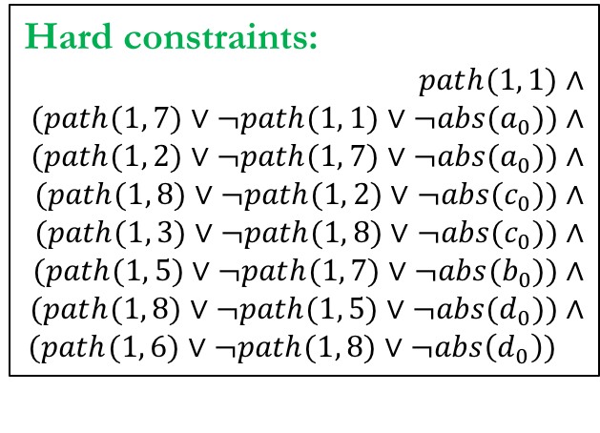
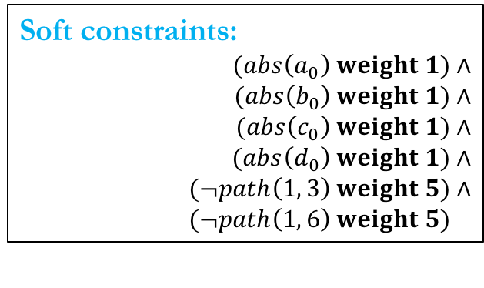
Encoding in MaxSAT
Avoid all the counterexamples
Hard constraints:
$$path(1, 1\text{)}∧$$
$$(path(1, \text{7}\text{)}∨¬path(1, \text{1)}∨¬abs(a_{0})\text{)}∧$$
$$(path(1, \text{2}\text{)}∨¬path(1, \text{7}\text{)}∨¬abs(a_{0})\text{)}∧$$
$$(path(1, \text{8}\text{)}∨¬path(1, \text{2}\text{)}∨¬abs(c_{0})\text{)}∧$$
$$(path(1, \text{3}\text{)}∨¬path(1, \text{8}\text{)}∨¬abs(c_{0})\text{)}∧$$
$$(path(1, \text{5}\text{)}∨¬path(1, \text{7}\text{)}∨¬abs(b_{0})\text{)}∧$$
$$(path(1, \text{8}\text{)}∨¬path(1, \text{5}\text{)}∨¬abs(d_{0})\text{)}∧$$
$$(path(1, \text{6}\text{)}∨¬path(1, \text{8}\text{)}∨¬abs\left(d_{0}\right)\text{)}$$
Minimize the abstraction cost
Soft constraints:
$$(abs\left(a_{0}\right) weight 1)∧$$
$$(abs\left(b_{0}\right) weight 1)∧$$
$$(abs\left(c_{0}\right) weight 1)∧$$
$$(abs\left(d_{0}\right) weight 1)∧$$
$$(¬path\left(1, 3\right) weight 5)∧$$
$$(¬path\left(1, 6\right) weight 5)∧$$
abs(a₀)$⨁$abs(a₁), abs(b₀)$⨁$abs(b₁),
abs(c₀)$⨁$abs(c₁), abs(d₀)$⨁$abs(d₁).

Slide 28
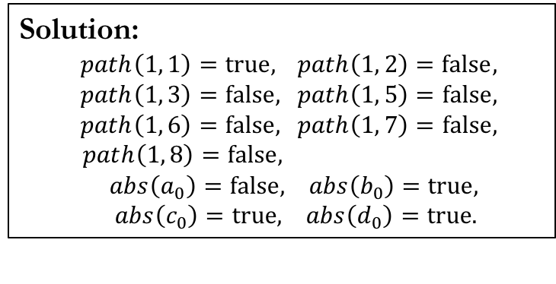
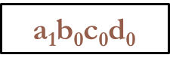
Encoding in MaxSAT
Solution:
$path\left(1, 1\right)=true,$ $path\left(1, 2\right)=false,$
$path\left(1, 3\right)=false,$ $path\left(1, 5\right)=false,$
$path\left(1, 6\right)=false,$ $path\left(1, 7\right)=false,$
$path\left(1, 8\right)=false, p,ath\left(0, 6\right)= 0,abs\left(a_{0}\right)=false, abs\left(b_{0}\right)=true,$
$abs\left(c_{0}\right)=true, abs\left(d_{0}\right)=true.$
Hard constraints:
$$path(1, 1\text{)}∧$$
$$(path(1, \text{7}\text{)}∨¬path(1, \text{1)}∨¬abs(a_{0})\text{)}∧$$
$$(path(1, \text{2}\text{)}∨¬path(1, \text{7}\text{)}∨¬abs(a_{0})\text{)}∧$$
$$(path(1, \text{8}\text{)}∨¬path(1, \text{2}\text{)}∨¬abs(c_{0})\text{)}∧$$
$$(path(1, \text{3}\text{)}∨¬path(1, \text{8}\text{)}∨¬abs(c_{0})\text{)}∧$$
$$(path(1, \text{5}\text{)}∨¬path(1, \text{7}\text{)}∨¬abs(b_{0})\text{)}∧$$
$$(path(1, \text{8}\text{)}∨¬path(1, \text{5}\text{)}∨¬abs(d_{0})\text{)}∧$$
$$(path(1, \text{6}\text{)}∨¬path(1, \text{8}\text{)}∨¬abs\left(d_{0}\right)\text{)}$$
a₁$\text{b}\text{0}$c₀d₀
Soft constraints:
$$(abs\left(a_{0}\right) weight 1)∧$$
$$(abs\left(b_{0}\right) weight 1)∧$$
$$(abs\left(c_{0}\right) weight 1)∧$$
$$(abs\left(d_{0}\right) weight 1)∧$$
$$(¬path\left(1, 3\right) weight 5)∧$$
$$(¬path\left(1, 6\right) weight 5)∧$$
Query | Eliminated Abstractions
q₁: path(1, 3) | a₀*c₀* (4/16)
q₂: path(1, 6) | a₀*c₀d₀, a₀b₀*d₀ (3/16)

Slide 29




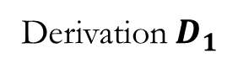
Iteration 2 and Beyond
Iteration 1
Derivation${ D}_{1}$
MaxSAT solver
Datalog solver
$$\text{Constraint}\text{s}$$
$$C_{1}$$
$$C_{1}∧$$
a₁$\text{b}\text{0}$c₀d₀
Query | Answer | Eliminated Abstractions
q₁: path(1, 3) |  | a₀*c₀* (4/16)
q₂: path(1, 6) |  | a₀*c₀d₀, a₀b₀*d₀ a (3/16)

Slide 30
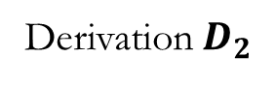
Iteration 2 and Beyond
Iteration 2
Derivation${ D}_{2}$
MaxSAT solver
Datalog solver
$$\text{Constraint}\text{s}$$
$$C_{1}$$
$$C_{1}∧$$
a₁$\text{b}\text{0}$c₀d₀
Query | Answer | Eliminated Abstractions
q₁: path(1, 3) |  | a₀*c₀* (4/16)
q₂: path(1, 6) |  | a₀*c₀d₀, a₀b₀*d₀ a (3/16)

Slide 31
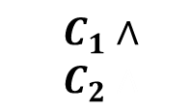
Iteration 2 and Beyond
Iteration 2
Derivation${ D}_{2}$
MaxSAT solver
Datalog solver
$$\text{Constraint}\text{s}$$
$$C_{1}$$
$$C_{1}∧$$
$$C_{2}∧$$
a₁$\text{b}\text{0}$c₀d₀
Query | Answer | Eliminated Abstractions
q₁: path(1, 3) |  | a₀*c₀* (4/16)
q₂: path(1, 6) |  | a₀*c₀d₀, a₀b₀*d₀ a (3/16)

Slide 32
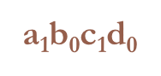
Iteration 2 and Beyond
Iteration 2
Derivation${ D}_{2}$
MaxSAT solver
Datalog solver
$$\text{Constraint}\text{s}$$
$$C_{1}$$
$$C_{1}∧$$
$$C_{2}∧$$
a₁$\text{b}\text{0}$c₁d₀
Query | Answer | Eliminated Abstractions
q₁: path(1, 3) |  | a₀*c₀*, a₁*c₀* (8/16)
q₂: path(1, 6) |  | a₀*c₀d₀, a₀b₀*d₀, a₁*c₀d₀ a (5/16)

Slide 33
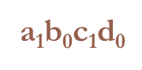
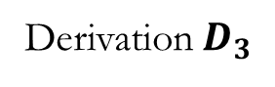
Iteration 2 and Beyond
Iteration 3
Derivation${ D}_{3}$
MaxSAT solver
Datalog solver
$$\text{Constraint}\text{s}$$
$$C_{1}$$
$$C_{1}∧$$
$$C_{2}∧$$
q₂ is proven.
a₁$\text{b}\text{0}$c₁d₀
Query | Answer | Eliminated Abstractions
q₁: path(1, 3) |  | a₀*c₀*, a₁*c₀* (8/16)
q₂: path(1, 6) |  | a₀*c₀d₀, a₀b₀*d₀, a₁*c₀d₀ a (5/16)
a₁$\text{b}\text{0}$c₁d₀

Slide 34
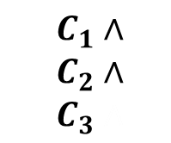
Iteration 2 and Beyond
Iteration 3
Derivation${ D}_{3}$
MaxSAT solver
Datalog solver
$$\text{Constraint}\text{s}$$
$$C_{1}$$
$$C_{1}∧$$
$$C_{2}∧$$
$$C_{3}∧$$
q₂ is proven.
a₁$\text{b}\text{0}$c₁d₀
Query | Answer | Eliminated Abstractions
q₁: path(1, 3) |  | a₀*c₀*, a₁*c₀* (8/16)
q₂: path(1, 6) |  | a₀*c₀d₀, a₀b₀*d₀, a₁*c₀d₀ a (5/16)
a₁$\text{b}\text{0}$c₁d₀

Slide 35
Iteration 2 and Beyond
Iteration 3
Derivation${ D}_{3}$
MaxSAT solver
Datalog solver
$$\text{Constraint}\text{s}$$
$$C_{1}$$
$$C_{1}∧$$
$$C_{2}∧$$
$$C_{3}∧$$
q₂ is proven.
q₁ is impossible to prove.
a₁$\text{b}\text{0}$c₁d₀
Query | Answer | Eliminated Abstractions
q₁: path(1, 3) |  | a₀*c₀*, a₁*c₀*, a₀*c₁*, a₁*c₁* (16/16)
q₂: path(1, 6) |  | a₀*c₀d₀, a₀b₀*d₀, a₁*c₀d₀ a (5/16)
Impossibility
a₁$\text{b}\text{0}$c₁d₀

Slide 36
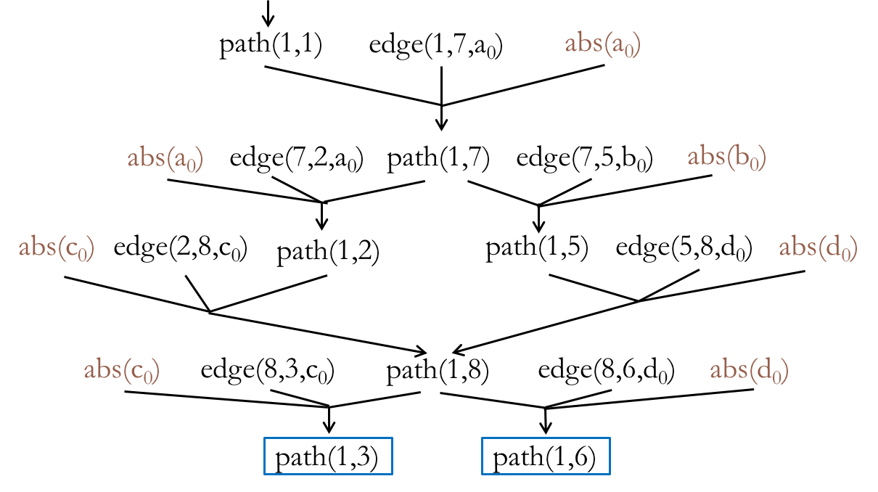
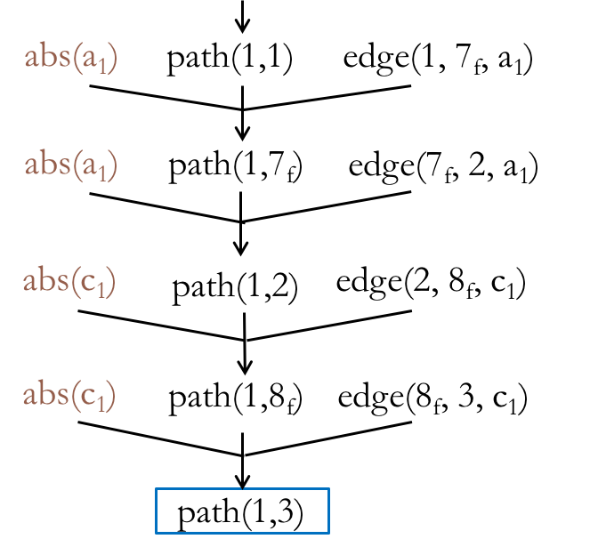


Mixing Counterexamples
Iteration 1
Iteration 3
Eliminated
Abstractions:
a₀$∗$c₀$∗$
a₁$∗$c₁$∗$

Slide 37
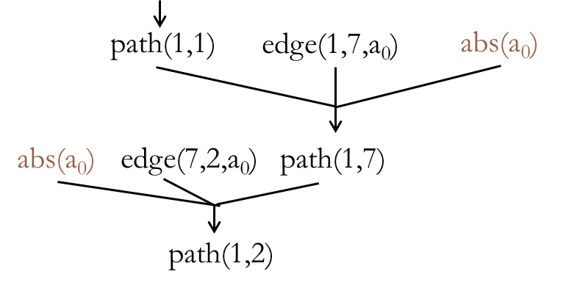
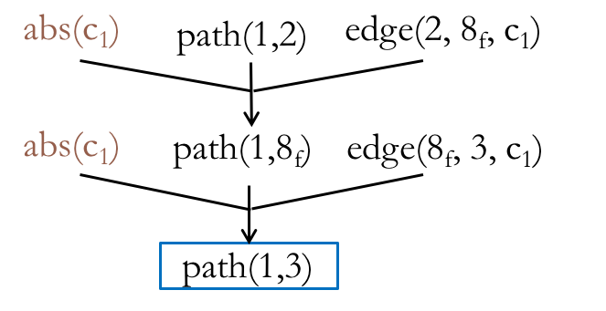

Mixing Counterexamples
Iteration 1
Mixed!
Iteration 3
Eliminated
Abstractions:
a₀$∗$c₀$∗$
a₀$∗$c₁$∗$
a₁$∗$c₁$∗$

Slide 38
Experimental Setup
Implemented using off-the-shelf solvers
Datalog: bddbddb
MaxSAT: MiFuMaX
Applied to two analyses that are challenging to scale
k-object-sensitivity pointer analysis
flow-insensitive, weak updates, cloning-based
typestate analysis
flow-sensitive, strong updates, summary-based
Evaluated on 8 Java programs (250-450 KLOC each)
76 rules, 50 input relations, 42 output relations
52 rules, 33 input relations, 14 output relations

Slide 39
Pointer Analysis Results
4-object-sensitivity
< 50%
 | queries |  |  | abstraction size |  | iterations
 | total | resolved
 |  | current | baseline | final | max
toba-s | 7 | 7 | 0 | 170 | 18K | 10
javasrc-p | 46 | 46 | 0 | 470 | 18K | 13
weblech | 5 | 5 | 2 | 140 | 31K | 10
hedc | 47 | 47 | 6 | 730 | 29K | 18
antlr | 143 | 143 | 5 | 970 | 29K | 15
luindex | 138 | 138 | 67 | 1K | 40K | 26
lusearch | 322 | 322 | 29 | 1K | 39K | 17
schroeder-m | 51 | 51 | 25 | 450 | 58K | 15
< 3% of max

Slide 40
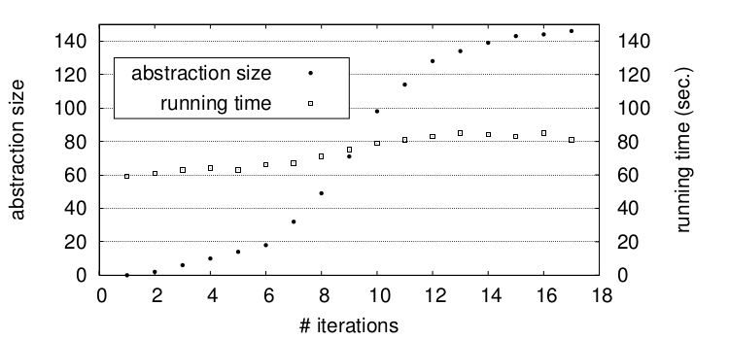
Performance of Datalog Solver
k = 4, 3h28m
Baseline
k = 3, 590s
k = 2, 214s
lusearch
k = 1, 153s

Slide 41
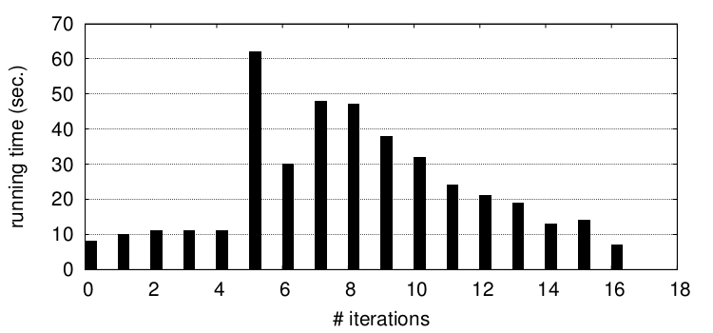
Performance of MaxSAT Solver
lusearch

Slide 42
Statistics of MaxSAT Formulae
 | pointer analysis
 | variables | clauses
toba-s | 0.7M | 1.5M
javasrc-p | 0.5M | 0.9M
weblech | 1.6M | 3.3M
hedc | 1.2M | 2.7M
antlr | 3.6M | 6.9M
luindex | 2.4M | 5.6M
lusearch | 2.1M | 5.0M
schroeder-m | 6.7M | 23.7M

Slide 43
New Challenges in MaxSAT
M = million
Benchmark | # Vars | # Clauses | Solver Runtime (secs)
 |  |  | CCLS2akms | MaxHS | Eva500
antlr | 3.6M | 6.9M
lusearch | 2.4M | 5.0M
luindex | 6.7M | 23.7M
avrora | 4.5M | 17.6M
xalan | 5.6M | 19.2M
Notes:
The table on this slide shows the MaxSAT instances generated from our PLDI’14 paper, which uses MaxSAT to find good abstractions for analyses written in Datalog. The instances here are a order of magnitude larger than the instances we showed in last slide. We tried to solve them using the top three solvers from MaxSAT competition 2014. While two solvers managed to finish on the three smaller instances, none of them can finish on the larger two instances within 24 hours.
Don’t say PLDI’14, but recent work

Slide 44
New Challenges in MaxSAT
M = million, timeout = 24 hours
Benchmark | # Vars | # Clauses | Solver Runtime (secs)
 |  |  | CCLS2akms | MaxHS | Eva500
antlr | 3.6M | 6.9M | timeout | 22.6 | 38.2
lusearch | 2.4M | 5.0M | timeout | 23.9 | 31
luindex | 6.7M | 23.7M | timeout | 8.9 | 22
avrora | 4.5M | 17.6M
xalan | 5.6M | 19.2M
Notes:
For example, the table shows the instances generated from our PLDI’14 paper, which uses MaxSAT to find good abstractions for analyses written in Datalog. The instances here are a order of magnitude larger than the instances we showed on last slide. We picked three top solvers from MaxSAT competition 2014. As we can see, all three solvers timed out on the larger two benchmarks after 24 hours. Note the benchmark programs we have here are all from Dacapo suite, and they’re not the largest from this suite.

Slide 45
New Challenges in MaxSAT
M = million, timeout = 24 hours
Benchmark | # Vars | # Clauses | Solver Runtime (secs)
 |  |  | CCLS2akms | MaxHS | Eva500
antlr | 3.6M | 6.9M | timeout | 22.6 | 38.2
lusearch | 2.4M | 5.0M | timeout | 23.9 | 31
luindex | 6.7M | 23.7M | timeout | 8.9 | 22
avrora | 4.5M | 17.6M | timeout | timeout | timeout
xalan | 5.6M | 19.2M | timeout | timeout | timeout
Notes:
For example, the table shows the instances generated from our PLDI’14 paper, which uses MaxSAT to find good abstractions for analyses written in Datalog. The instances here are a order of magnitude larger than the instances we showed on last slide. We picked three top solvers from MaxSAT competition 2014. As we can see, all three solvers timed out on the larger two benchmarks after 24 hours. Note the benchmark programs we have here are all from Dacapo suite, and they’re not the largest from this suite.
10^6 -> million

Slide 46
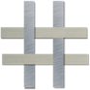
Our Solution: Nichrome
Petablox enables new problem definitions which are not limited to program reasoning, which in turn yields new efficient algorithms.

Slide 47
Our Solution: Nichrome
Query-guided maximum satisfiability.
Incremental maximum satisfiability.
Does variable head alias with variable tail on line 50 in Complex.java?
Is Dijkstra most likely an author of “Structured Programming”?
MaxSAT solver
Datalog solver
$$\text{Constraint}\text{s}$$
$$C_{1}$$
$$C_{1}∧$$
$$C_{2}∧$$
$$C_{3}∧$$

Slide 48
Our Solution: Nichrome
Query-guided maximum satisfiability.
Incremental maximum satisfiability.
Xin Zhang, Ravi Mangal, Aditya V. Nori, and Mayur Naik. Query-Guided Maximum Satisfiability. POPL 2016
Xujie Si, Xin Zhang, Vasco Manquinho, Mikolas Janota, Alexey Ignatiev, and Mayur Naik.. On Incremental Core-Guided MaxSAT Solving. CP 2016

Slide 49
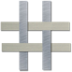
Performance Results [POPL 2016]
 | running time (seconds) |  | peak memory (MB) |  | # clauses (M = million) |  | # iters | last iter. time (seconds)
 |  | Baseline |  | Baseline |  | Baseline
ftp | 16 | 11 | 16 | 1,262 | 29K | 3M | 9 | 0.1
hedc | 23 | 21 | 181 | 1,918 | 400K | 4.8M | 7 | 3
weblech | 4 | timeout | 363 | timeout | 922K | 8.4M | 1 | 4
antlr | 190 | timeout | 1,405 | timeout | 3.3M | 13M | 9 | 14
avrora | 178 | timeout | 1,095 | timeout | 2.6M | 16.3M | 8 | 13
chart | 253 | timeout | 721 | timeout | 1.8M | 22.3M | 6 | 8
luindex | 169 | timeout | 944 | timeout | 2.2M | 11.9M | 8 | 12
AR | 4 | timeout | 4 | timeout | 2K | 7.9M | 7 | 0.3
ER | 13 | 2 | 6 | 44 | 9K | 4.8M | 19 | 0.2
IE | 2 | 2,760 | 13 | 335 | 27K | 0.9M | 7 | 0.05

Slide 50
Performance Results [CP 2016]
1.8X Speedup

Slide 51
Conclusion: Current Status
Datalog-based Frameworks
MaxSAT-based Optimizations
Analysis Writer (Alice)
Finding optimum abstractions.
Incorporating user feedback.
Reusing results on shared libraries.
…
Query-guided MaxSAT solving.
Incremental MaxSAT solving.
…

Slide 52
Conclusion: Future
Analysis Writer (Alice)
Analysis User (Bob)

Slide 53
References
Petablox: http://petablox.org.
Nichrome: http://nichrome.org.

Slide 54
Idea: Synthesize Analysis Use-Cases
Soundness
Hard constraints:
$$path(1, 1\text{)}∧$$
$$(path(1, \text{7}\text{)}∨¬path(1, \text{1)}∨¬abs(a_{0})\text{)}∧$$
$$(path(1, \text{2}\text{)}∨¬path(1, \text{7}\text{)}∨¬abs(a_{0})\text{)}∧$$
$$(path(1, \text{8}\text{)}∨¬path(1, \text{2}\text{)}∨¬abs(c_{0})\text{)}∧$$
$$(path(1, \text{3}\text{)}∨¬path(1, \text{8}\text{)}∨¬abs(c_{0})\text{)}∧$$
$$(path(1, \text{5}\text{)}∨¬path(1, \text{7}\text{)}∨¬abs(b_{0})\text{)}∧$$
$$(path(1, \text{8}\text{)}∨¬path(1, \text{5}\text{)}∨¬abs(d_{0})\text{)}∧$$
$$(path(1, \text{6}\text{)}∨¬path(1, \text{8}\text{)}∨¬abs\left(d_{0}\right)\text{)}$$
Input relations:
edge(a, b)
Output relations:
path(a, b)
Rules:
1path(a, a).
2path(a, c) :- path(a, b), edge(b, c).
Soft constraints:
$$(abs\left(a_{0}\right) weight 1)∧$$
$$(abs\left(b_{0}\right) weight 1)∧$$
$$(abs\left(c_{0}\right) weight 1)∧$$
$$(abs\left(d_{0}\right) weight 1)∧$$
$$(¬path\left(1, 3\right) weight 5)∧$$
$$(¬path\left(1, 6\right) weight 5)∧$$
Tradeoffs

